Slide 1
August 8th Meeting
Ainsley Lai

Slide 2
Agenda
Combined location plots for Speed, Range, Rx Level
Rx Level vs. Speed & Log relationship
Expansion to other MMSI
Investigation into literature to check if speed is in dB

Slide 3
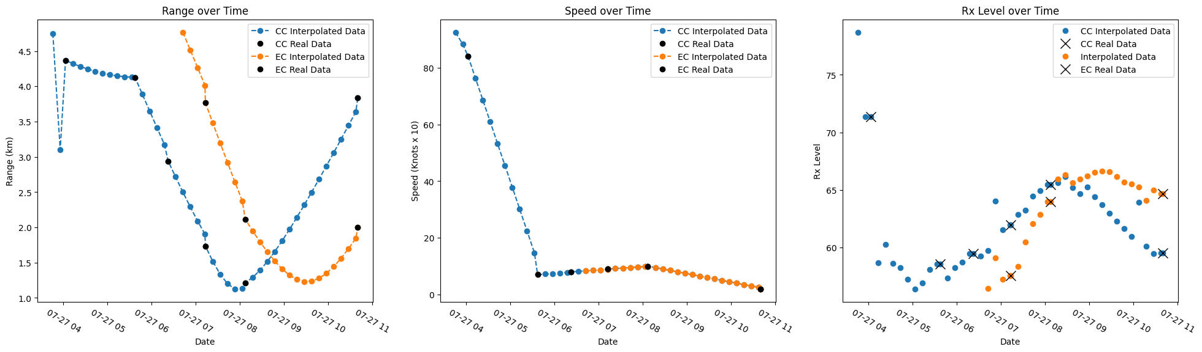
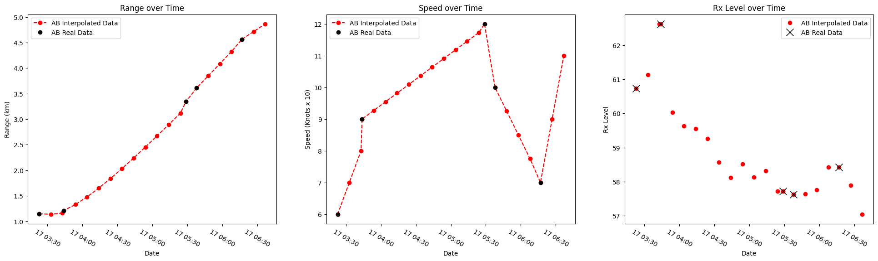
MMSI 356190000 Speed, Range, Rx Level
<5km
AB different date

Slide 4
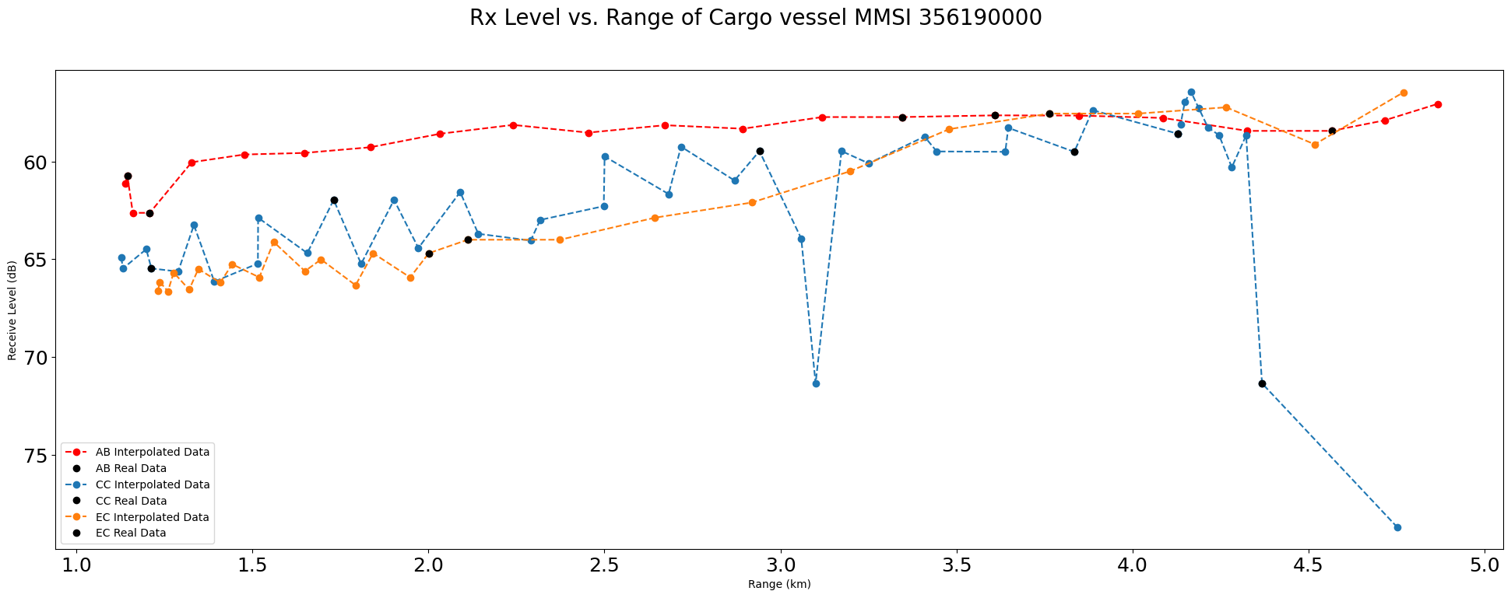
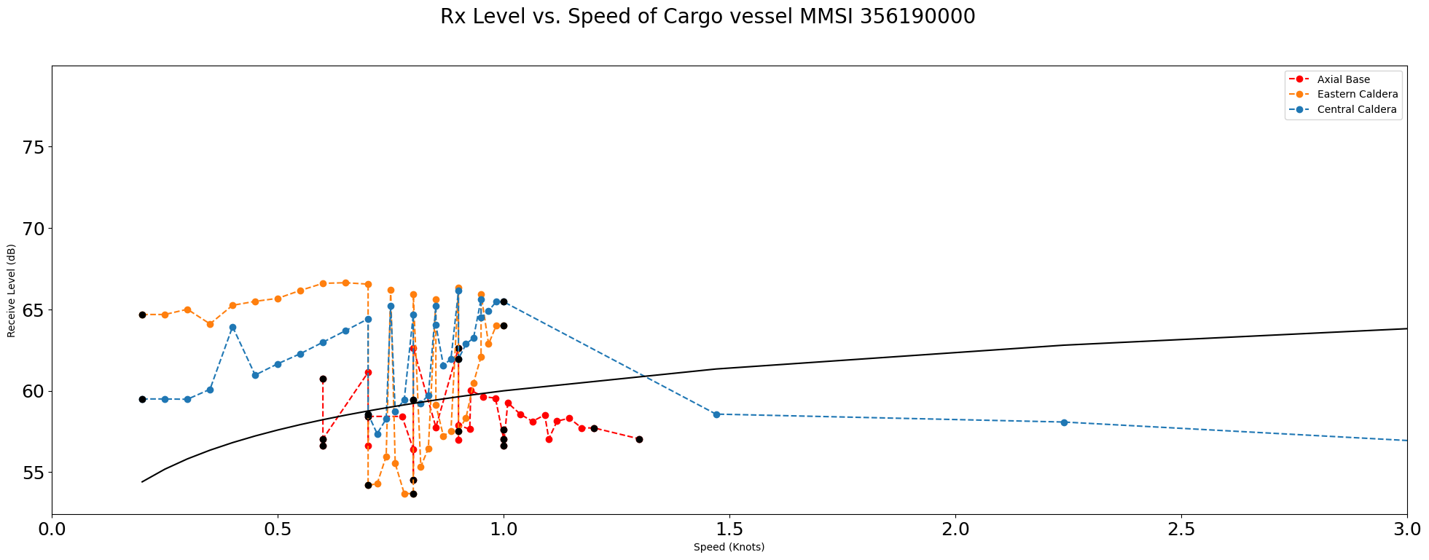
MMSI 356190000 Rx Level
No apparent log relation in Rx vs. Speed

Slide 5
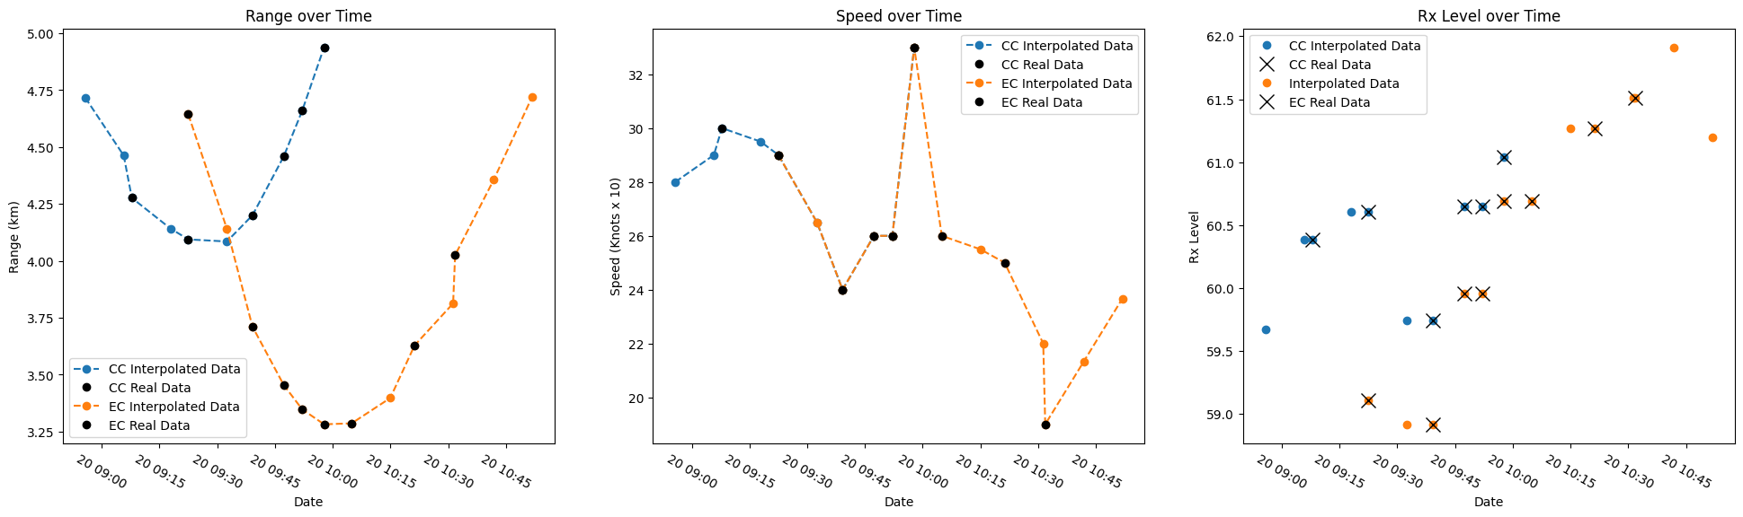
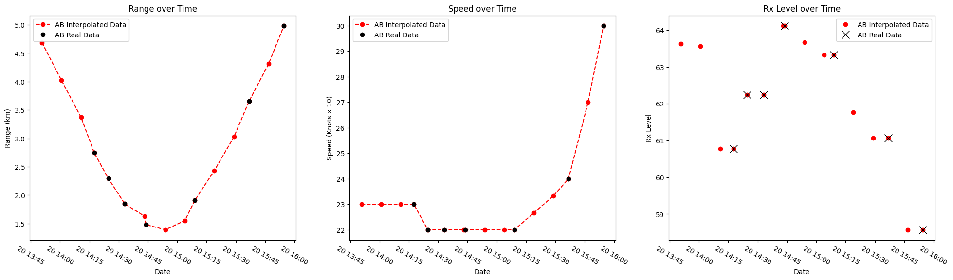
MMSI 352358000 Speed, Range, Rx Level
<5km
AB different date

Slide 6
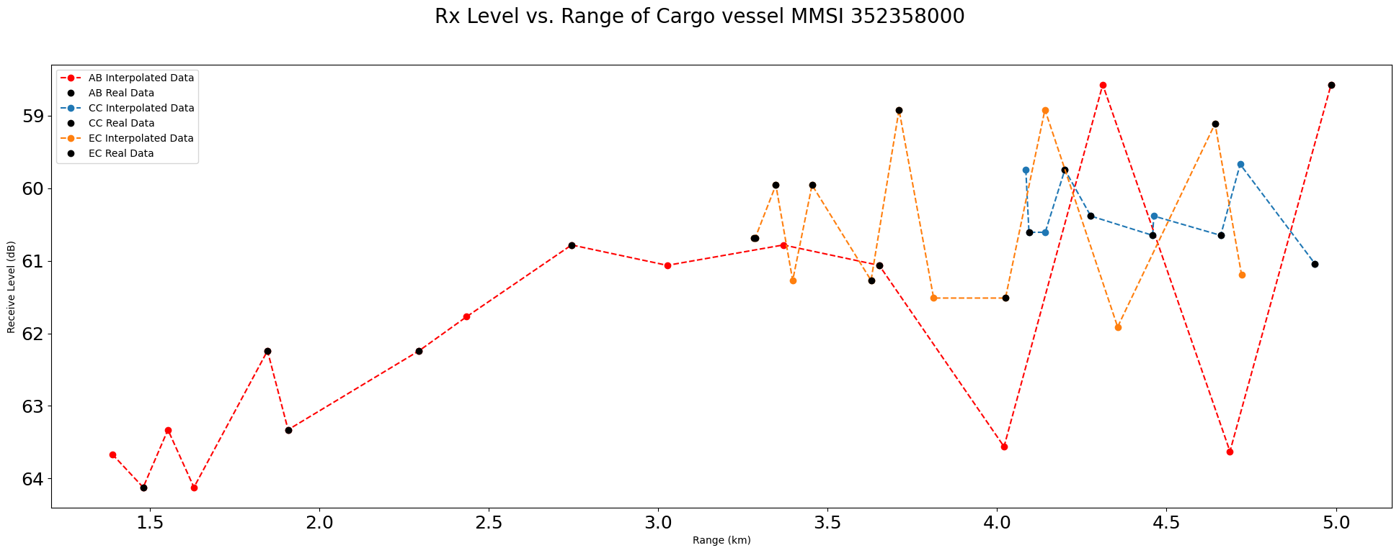
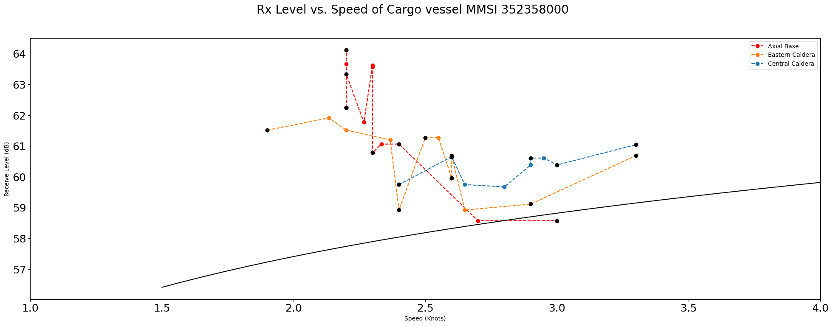
MMSI 352358000 Rx Level
No apparent log relation in Rx vs. Speed

Slide 7
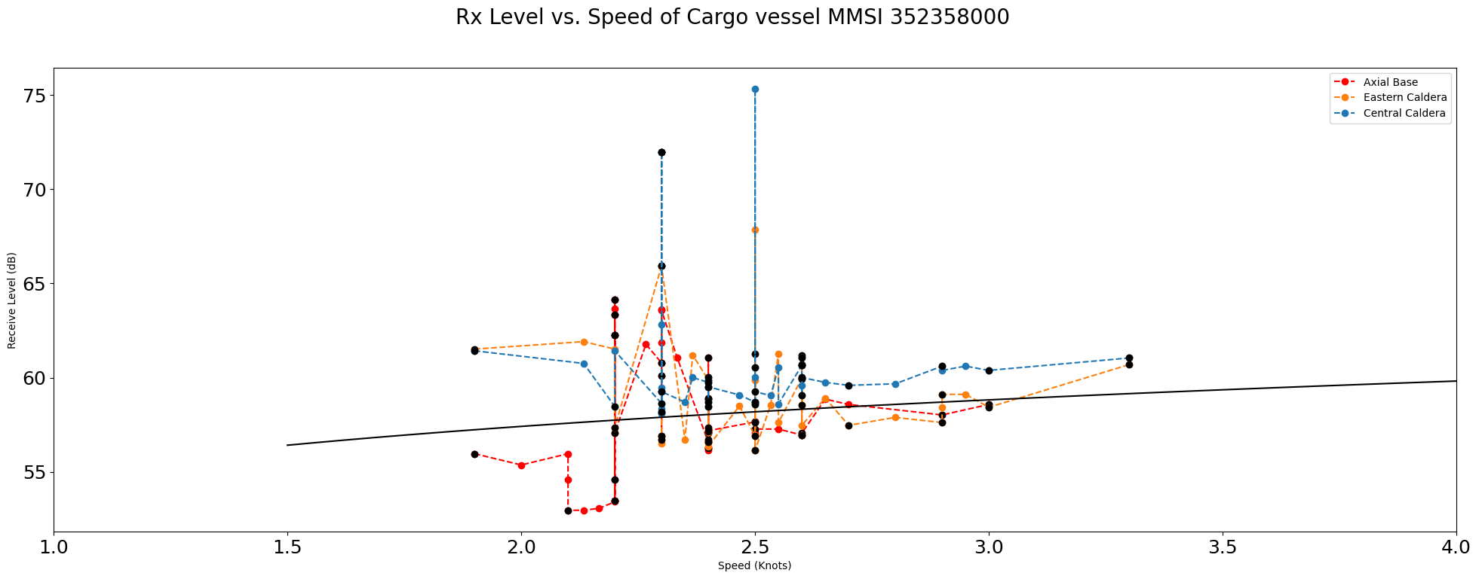
MMSI 352358000 Rx Level
No apparent log relation in Rx vs. Speed
Filtered to allow all ranges

Slide 8
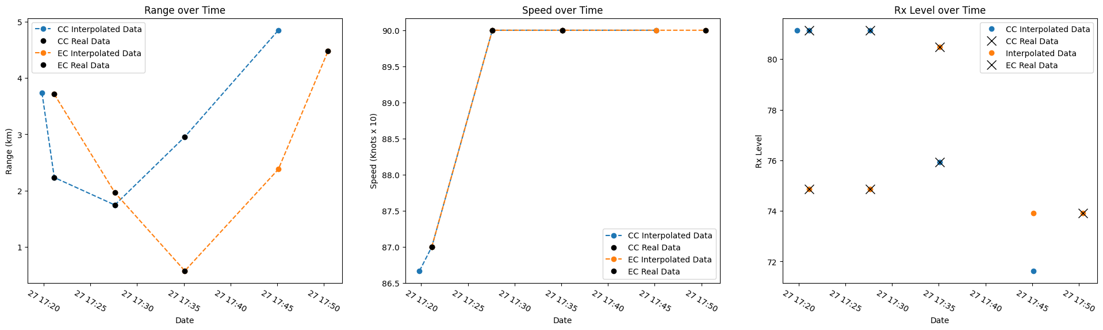
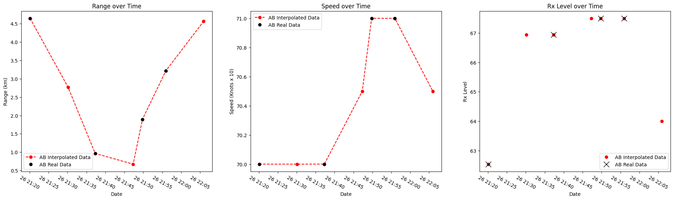
MMSI 538005544 Speed, Range, Rx Level
<5km
AB different date

Slide 9
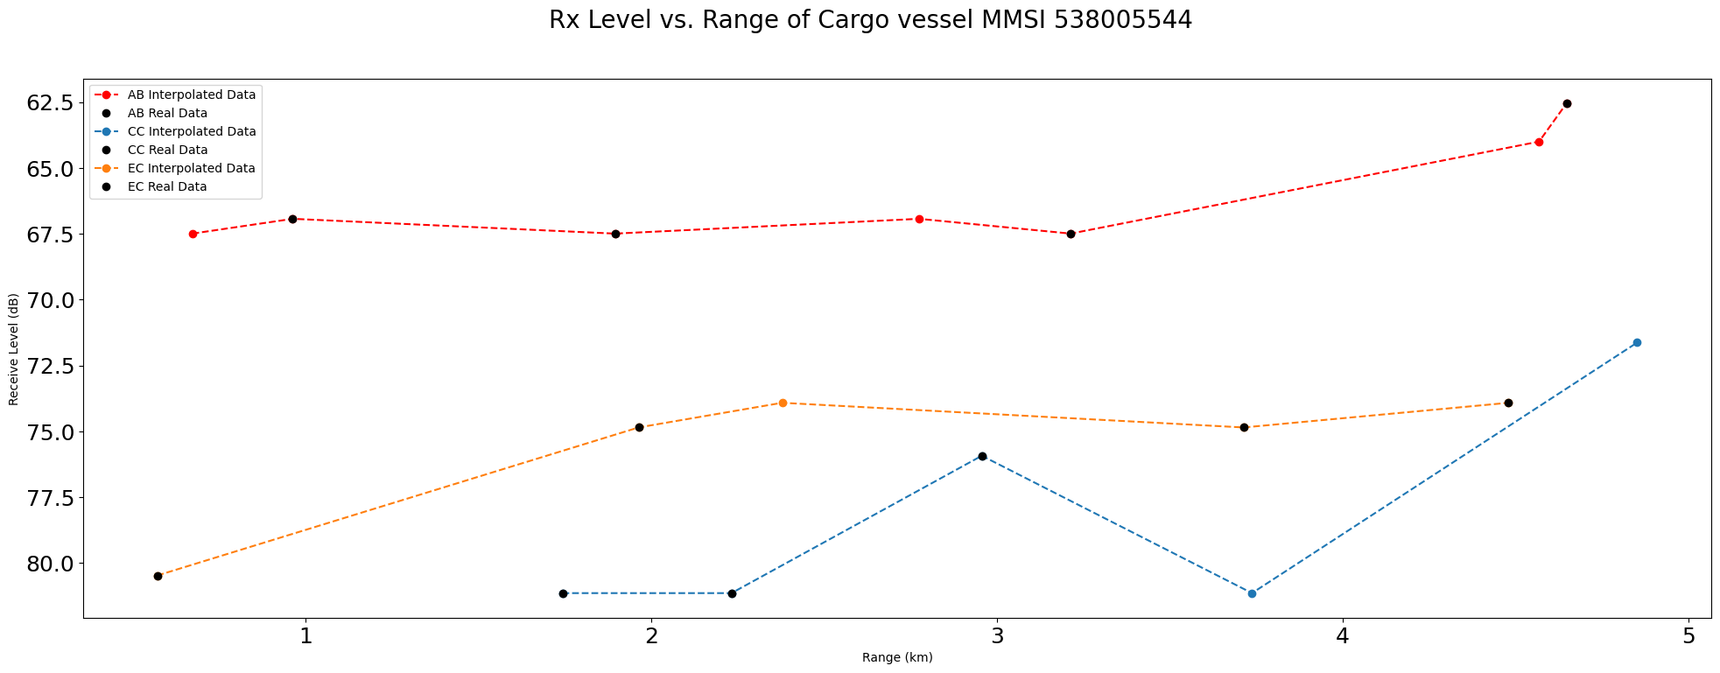
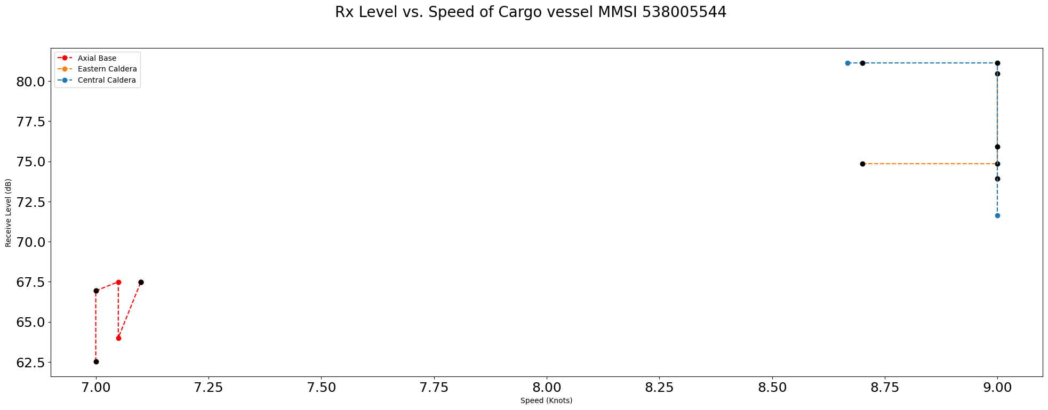
MMSI 538005544 Rx Level
No apparent log relation in Rx vs. Speed

Slide 10
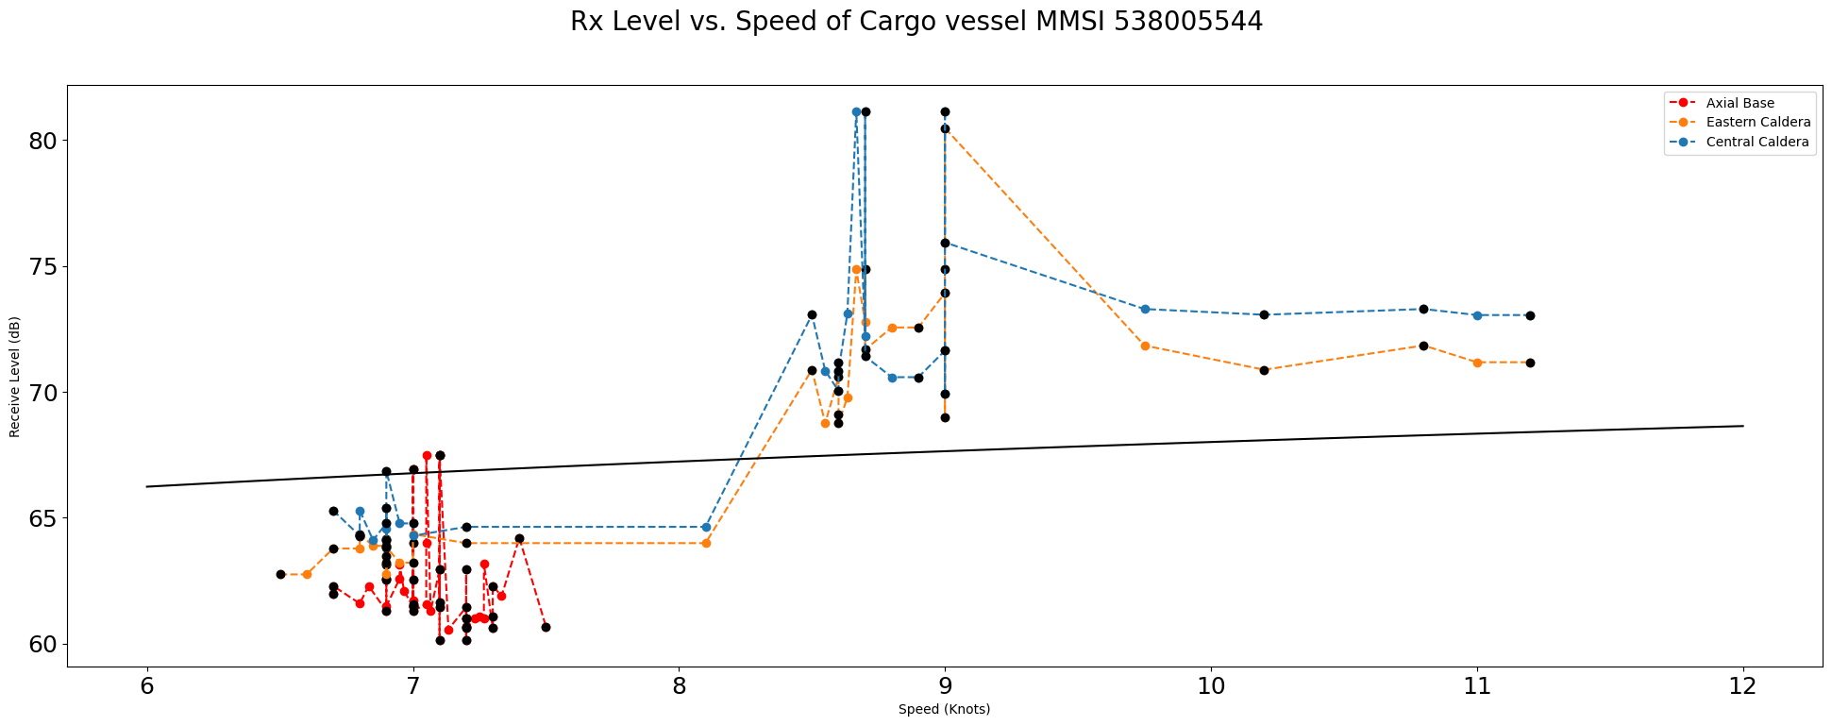
MMSI 538005544 Rx Level
No apparent log relation in Rx vs. Speed
Filtered to allow all ranges

